Slide 1
BIGTECH COMPANY
Financial overview

Slide 2
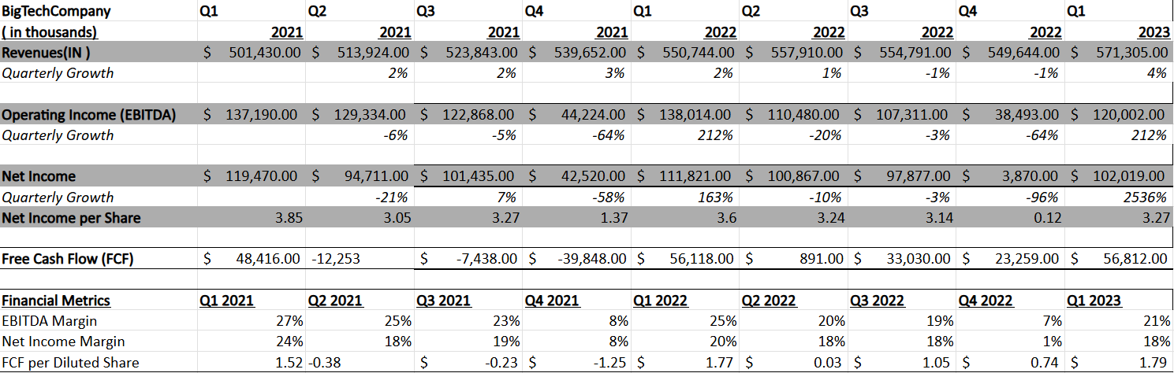
.
QUARTERLY PERFORMANCE

Slide 3
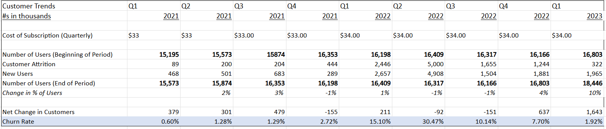
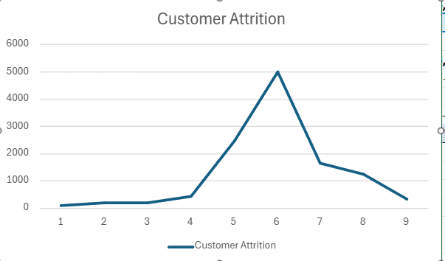
.
CONSUMER TRENDS
KEY TAKEAWAYS:-
1)
This line graph clearly depicts that due to the increase in the subscription cost, there was an intial rise in the customer attrition until 2022(Q2), aftwe which it started declining.
2) The churn rate i.e, the rate of loss of customer trend out of the previous period; also demonstrates the forementioned relationship.
3) Irrespective of the trends in the churn rate, the numbers of users at each period is always rising(except from 2022(Q1 to Q3).

Slide 4
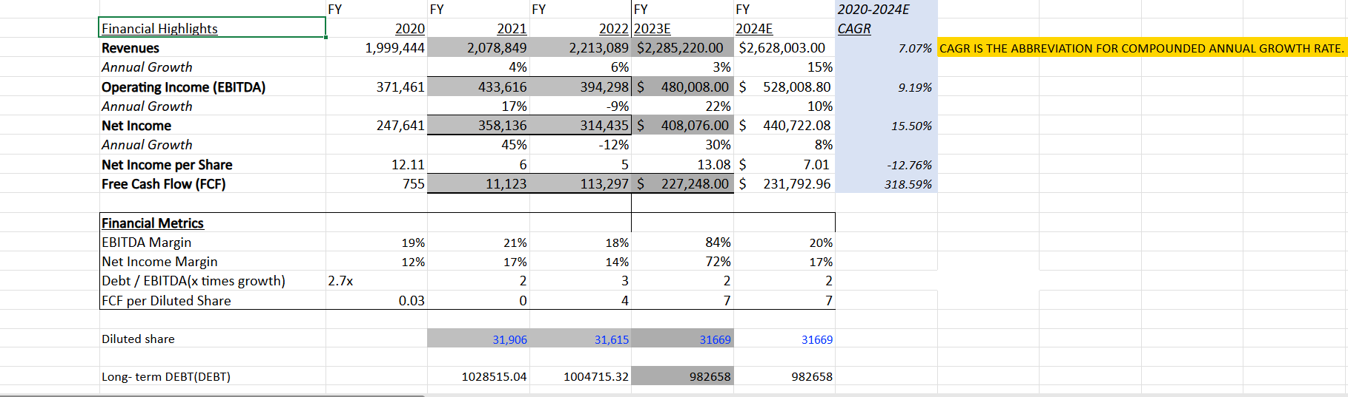
PROJECTIONS

Slide 5
CONCLUSIONS
COMPANY HIGHLIGHTS:-
1) We can see an upwards trend in the revenue of the company. From $1,999,444 in 2020 to $2,628,003 in 2024, we can clearly see that company has a positive earning capability.
2) Company has made a massive leap in their cash flow segment, cash flows went from as low as $755 dollars in 2020 to a considerable amount of $231,792.96 in the 2024. This shows that the company is highly liquid and can easily pay off their liabilities and expenses.
3) The company has been successfully mantaining a constant DEBT/EBITDA ratio remaining close to 2x. [ the highest went up to 3x], which is lower than the industry standard of 4x, meaning a healthy and safe ratio.
AREAS OF CONCERN:-
1) The EBITDA margin has been fairly low as compared to the industry level of 39%. It only surpassed this benchmark in 2023 wherein the margin was supernormally high at 84%.
2) There is irregularity in the net margin often crashing towards the negative counterpart. This shows that the company might be incurring unusually high costs and expenses which proves to be unstable in the long run.
3) The company experienced loss in their revenue during the 2022 session.

Slide 6
Recommendations:-
The company should aim to increase their EBITDA margin so that their earning capacity and profitability increases in the long run.
Company should track their expenses and keep it under a prescribed limit so that they do not happen to take debts in the near future.
The company should aim for a higher soothed rate of return, where the approach should be gradaulism rather than cold-turkey.

